Slide 1
Agile Bootcamp
Overview

Slide 2
Course Objectives
At the end of this session, you will be able to:
Explain how ISED is addressing the digital challenges that the GoC is facing
Define what Agile means and list the core values and principles
Identify the difference between Waterfall and Agile
Describe the benefits to using Agile

Slide 3
Lessons
The Big Picture: GoC and ISED
The Science of Productivity
What is Agile?
The Agile Mindset
Why Agile?

Slide 4
What is Digital?
GoC and ISED

Slide 5
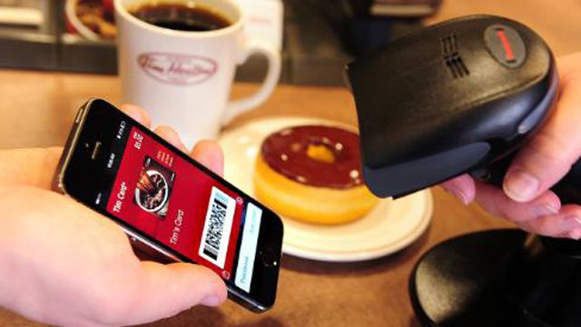
Raised Digital Expectations

Slide 6





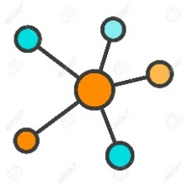



OneGC: The Vision
A long term vision for providing services to Canadians that are simple, seamless and available where they are
Any Service
Any Platform
Any Device
Any Partner
Passport Renewal
Filing Taxes
Collecting Social Benefits
Facebook
LinkedIn
Expedia
Smart Phones
TVs
Cars
Personal AI Assistants
Data
Projects
Open Source
Collaboration With all Sectors
Benefits of This Approach
Responds to citizens’ day-to-day needs – better services where they live and when they want them.
Empowers third parties to deliver innovative solutions for users.
Open and collaborative approach leads to better results and reusable solutions to address user needs.

Slide 7
ISED in Details
Become more innovative
Break down silos
Deliver faster
Consistent communication
Standardized processes
Continuous improvement
What is ISED doing? Addressing Digital Challenges
ISED: Is my service a digital initiative? Your service is a digital service if it delivers a service the public (including businesses).
ISED: Why Digital? To support the department’s mandate of helping industry become more productive and competitive in the global economy, we need to ensure our services are delivered in the most convenient and effective way.

Slide 8
How Is ISED Doing This? ISEDs Digital Playbook
Goals
People
Technology
ISEDs Digital Playbook
Using the Agile mindset, solutions :
Are developed with users not just for them
Offer a compelling user experience
Meet users where they are on their terms
Enable the user to solve their problem
Are developed using evidence-based decisions
Leverage technology in innovative ways
Agile
Notes:
Embraces the GC initiatives – specific for ISED

Slide 9
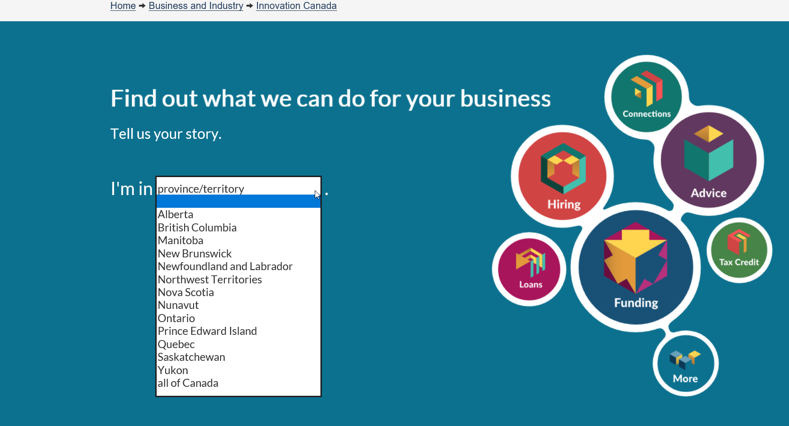
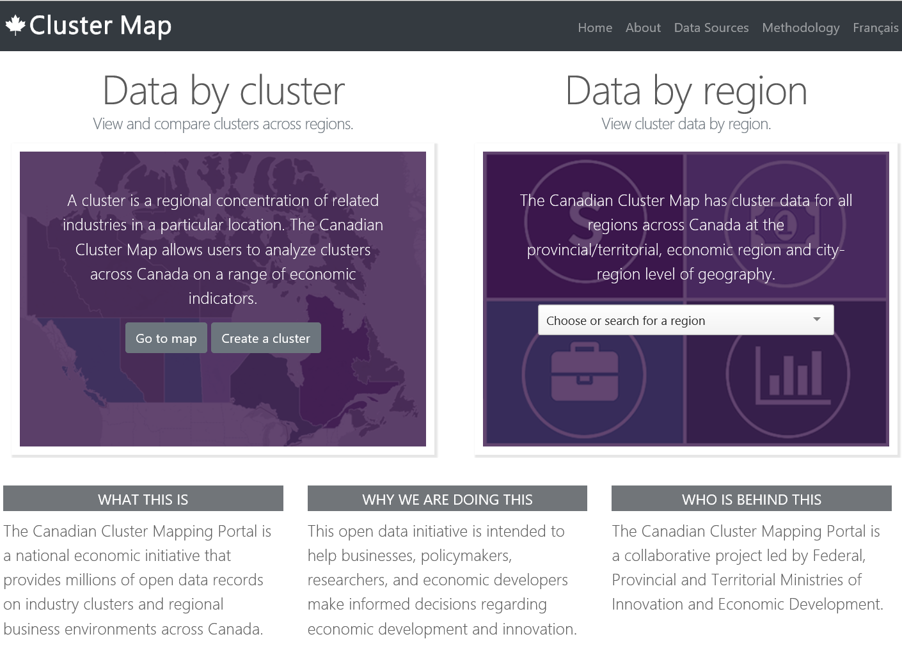
ISED in details - Successes
Innovation
Canada
Industry Sector Cluster Map
Notes:
TBS is challenging departments to become more innovative and to break down silos; as did our DM
Deliver faster – clients see more and more apps in the private sector and what something like that really quickly
Consistent communication and processes – everyone is on the same page and the messaging is aligned;
Standardized processes – everyone works in a consistent manner across teams
Continuous improvement – need to effect tangible permanent change

Slide 10
Agile
The Science of Productivity

Slide 11

Exercise: What is Agile?
Notes:
What does Agile mean to audience members?
Write all answers/concepts on a whiteboard or large piece of paper for the audience to see.
This exercise will help the instructors gauge the knowledge within the room.
This will also help us evaluate how far we’ve taken people through the training.

Slide 12
Science of Productivity
10:1
2,000:1
Notes:
A Yale study asked, how much effort goes into getting an “A”. Turned out, students can get an “A” with varying degrees of effort. The spread between the slowest and fastest individual obtaining an “A” was 10:1.
A similar study was conducted with 3,800 teams. The spread in speed between teams that achieved their objectives was 2,000:1.
Teams are much more complex to manage!

Slide 13
Successful Teams
Purpose
Autonomous
Cross-Functional
Success

Slide 14
Task Switching
Number of simultaneous projects | Percent of time available per project (all projects) | Loss to context switching
1 | 100% (100%) | 0%
2 | 40% (80%) | 20%
3 | 20% (60%) | 40%
4 | 10% (40%) | 60%
5 | 5% (25%) | 75%
Source: Quality Software Management, Gerald Weinberg

Slide 15
Team Size
7
^{+/-}2

Slide 16
Questions?

Slide 17
Agile
What is Agile?

Slide 18
The Agile Mindset
An agile mindset is the set of attitudes supporting an agile working environment.
Values
Principles
Agile
Mindset

Slide 19
Agile Values
Individuals and Interactions
over
Processes and Tools
Working Software
over
Comprehensive Documentation
Customer Collaboration
over
Contract Negotiation
Responding to Change
over
Following a Plan
While there is value in the items on the right, we value the items on the left more.
*
Agile Manifesto

Slide 20
Agile Principles…
Our highest priority is to satisfy the customer through early and continuous delivery of valuable software.
Business people and developers must work together daily throughout the project.
Welcome changing requirements, even late in development. Agile processes harness change for the customer's competitive advantage.
Build projects around motivated individuals. Give them the environment and support their need, and trust them to get the job done.
Deliver working software frequently, from a couple of weeks to a couple of months, with a preference to the shorter timescale.
The most efficient and effective method of conveying information to and within a development team is face-to-face conversation.
*
Agile Manifesto

Slide 21
…Agile Principles
Working software is the primary measure of progress.
Simplicity--the art of maximizing the amount of work not done--is essential.
Agile processes promote sustainable development. The sponsors, developers, and users should be able to maintain a constant pace indefinitely.
The best architectures, requirements, and designs emerge from self-organizing teams.
Continuous attention to technical excellence and good design enhances agility.
At regular intervals, the team reflects on how to become more effective, then tunes and adjusts its behavior accordingly.
*
Agile Manifesto

Slide 22
Exercise: Nickel Sprint

Slide 23
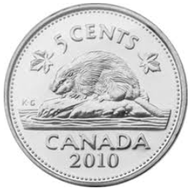
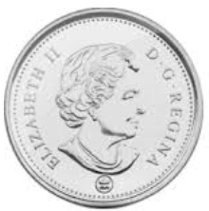
Exercise : Nickel Sprint
5 member agile team
1 Client (Product Owner)
4 Team Members
Team Members
Flip the defined number of coins
Move the coins to the next team member
Client
Times coin “delivery”

Slide 24
What Did We Observe?
Same number of coins and workers each sprint
Overall time is reduced with smaller batches
Less waiting (down time) and more working with smaller batches
The time to first delivery goes way down
Doing the same task a few times leads to proficiency

Slide 25
Agile
The Agile Mindset

Slide 26
Agile
Agile
Agile is a way of thinking based on a set of values & principles.
Behaviour-Driven Development (TDD)
Scaled Agile Framework (SAFe)
Scrum
eXtreme Programming (XP)
Agile thinking is supported by a group of software development frameworks and tools focused on iterative delivery, where requirements and solutions evolve through collaboration between self-organizing, cross-functional teams.
Test-Driven Development
Scrum is the most popular agile methodology in use in the industry and it is what we are using to begin our agile journey.
A Scrum is completed by a team, made up of different Roles, sprint Ceremonies, and Artifacts. Structure and discipline are maintained with Standards.
Roles
Cere-monies
Artifacts
Scrum

Slide 27
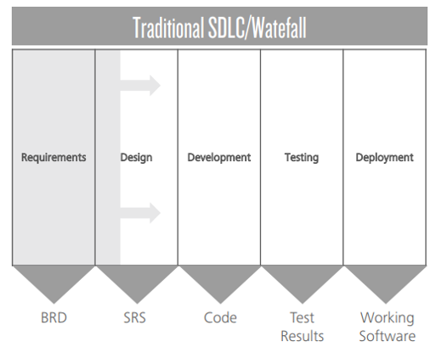
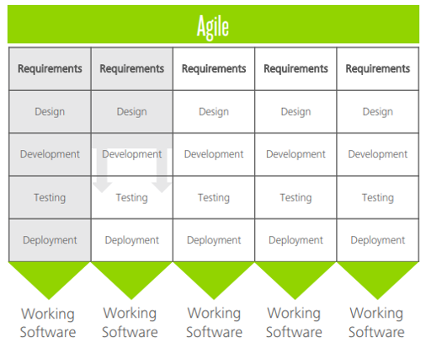
Today’s Mindset
Work Phases
Execution of work phases completed in single linear process. Permits change via defined change management process.
Waterfall
Teams
A project manager assigns tasks and directs teams. The work is organized around the team.
Execution
High quality work results from rigid structure, Little interaction with the business until the product is deployed.
VS.
Tomorrow’s Mindset
Work Phases
Smaller releases that include multiple iterations of product development. Allows requirements to change.
Agile
Teams
Self-organizing teams decide how to best accomplish their work. Teams have members across each competency needed to accomplish the work. The team is organized around the work.
Execution
High quality work results from team collaborations. Continuous interaction with the business (product owner) to make sure customer expectations are met.

Slide 28
What Agile is Not
It is not a single methodology
It is not a set of tools
It is not the “opposite” of Waterfall
It is not easy (it is easy to understand, it is not easy to implement)

Slide 29
Traditional Methods & Agile Behaviours
Management Method used | Less Agile | More Agile
Agile | 18.6% | 81.4%
Traditional | 62.2% | 37.8%
Hybrid | 30.4% | 69.6%
Source: Project Management Agility Global Survey. Massachusetts Institute of Technology, Consortium for Engineering Program Excellence – CEPE, Cambridge Massachusetts, USA

Slide 30
Risk Management
Manage risk through doing and iterative planning
Manage risk through heavy up front planning
Waterfall
Agile

Slide 31
Constraints
Scope
Cost
Time
Fixed
Waterfall
Agile
Variable
Cost
Time
Scope
Notes:
The scope will vary in agile, you need to change your expectations. The entire backlog of items will not necessarily be completed. BUT, you’ll be able to adapt to the changing environment and adapt to user feedback.
Fixing SCOPE and COST and TIME is a recipe for failure regardless of the methodology

Slide 32
Questions?

Slide 33
Agile
Why Agile?

Slide 34
Why Be Agile?
Benefits to ISED
Benefits to ISED Programs
Benefits to Canadians
Faster feedback cycle
Higher Product Quality
Provide value for Canadians faster
Prioritized features
Higher Customer Satisfaction
Focus on key user needs
Flexible prioritization
Increased Project Control
Provide insight-driven solutions
Change is constant
Reduced Risk
Provide frictionless experience to users
Frequent releases
Faster Return on Investment
Reduced resource burden

Slide 35
Key Takeaways
Agile is a way of thinking based on a set of values and principles
Agile thinking focuses on adapting to change, rather than delivering a fixed scope
Agile delivery encourages reduction in batch size
1
2
3

Slide 36
Exercise: Shaping a Point

